Slide 1

Presented by
B.Josy,
3rd year computer science and engineering,
Universal college of engineering and technology.

Slide 2
Keyloggers definition
A keyloggeris a type of software or hardware device that records every keystroke
made by a user on a computer or mobile device.This includes capturing keyboard
inputs such as passwords,usernames,messages,and other sensitive information.
Keyloggerscan be used for various purposes,such as monitoring computer activity,parental control,or in malicious activities like stealing confidentinal information

Slide 3
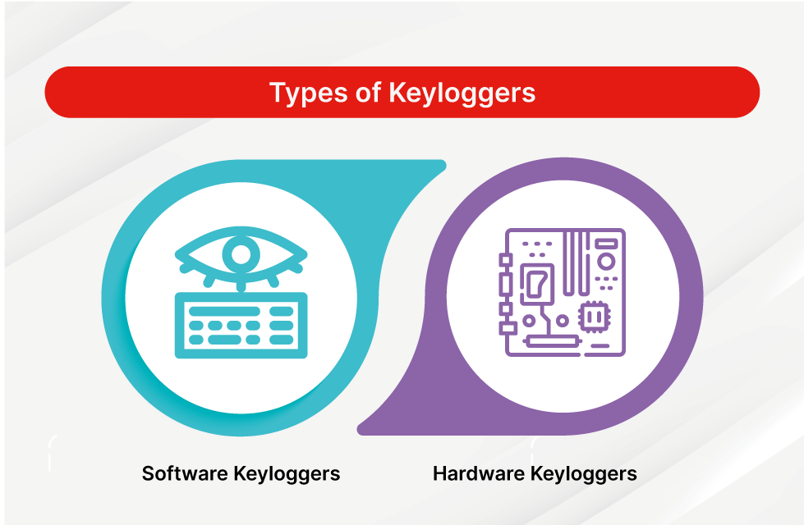
Type of keyloggers
There are two types of keyloggers,
Hardware
Software

Slide 4
Hardware
They are the most common method hackers use to access a user’s keystrokes. ▪A software keyloggeris put on a computer when the user downloads an infected.
Once installed,the keyloggermonitors the keystrokes on the operating
system you are using,checking the paths each keystroke goes through.In this way,a
software keyloggercan keep track of your keystrokes and record each one.
▪After the keystrokes have been recorded,they are then automatically transferred to the

Slide 5
Software
The downloading has to be performed only after the keyloggerhas finished logging keystrokes.This is because it is not possible for the hacker to get the data while the key logger is working.In some cases,the hacker may make the
keylogging device accessible viaWi-Fi.This way,they do not have to physically
walk up to the hacked computer to get the device and retrieve the data.

Slide 6
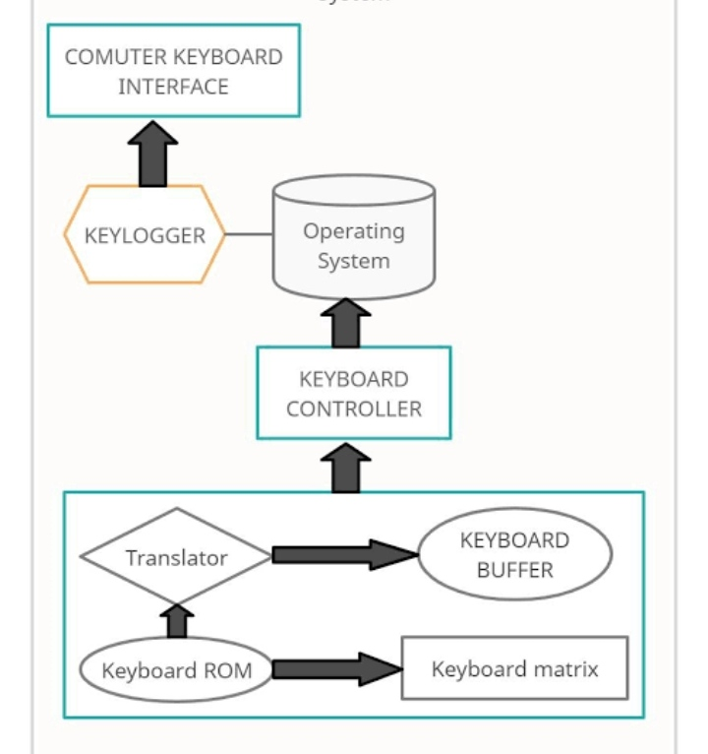
Architecture

Slide 7
Keyloggers cyber crime
Keyloggers are a type of malware that is downloaded onto a device through an entry point. Entry points can be infected software, emails, files or cloud programs. When keylogging software gets installed on a victim's device, it logs every keystroke to gather login credentials and other sensitive information.

Slide 8
Thank you

